Slide 1

Green Destination Data Analysis
By Shorrya Verma

Slide 2

Objective
Green destination is a well known travel agency. The HR Director has recently noticed an increase in employees leaving(attrition). She would like to figure out any trends or patterns. She has surveyed the staff of green destinations and provided data
She would like to know what the attrition rate is (% of people who have left).
She would also like to know if factors like age, years at company and income play a part in determining if people will leave or not.

Slide 3
Quick Insights
16.12%
Attrition rate
1470
Total Employees

Slide 4
% of Attrition

Slide 5
Employee attrition by age

Slide 6
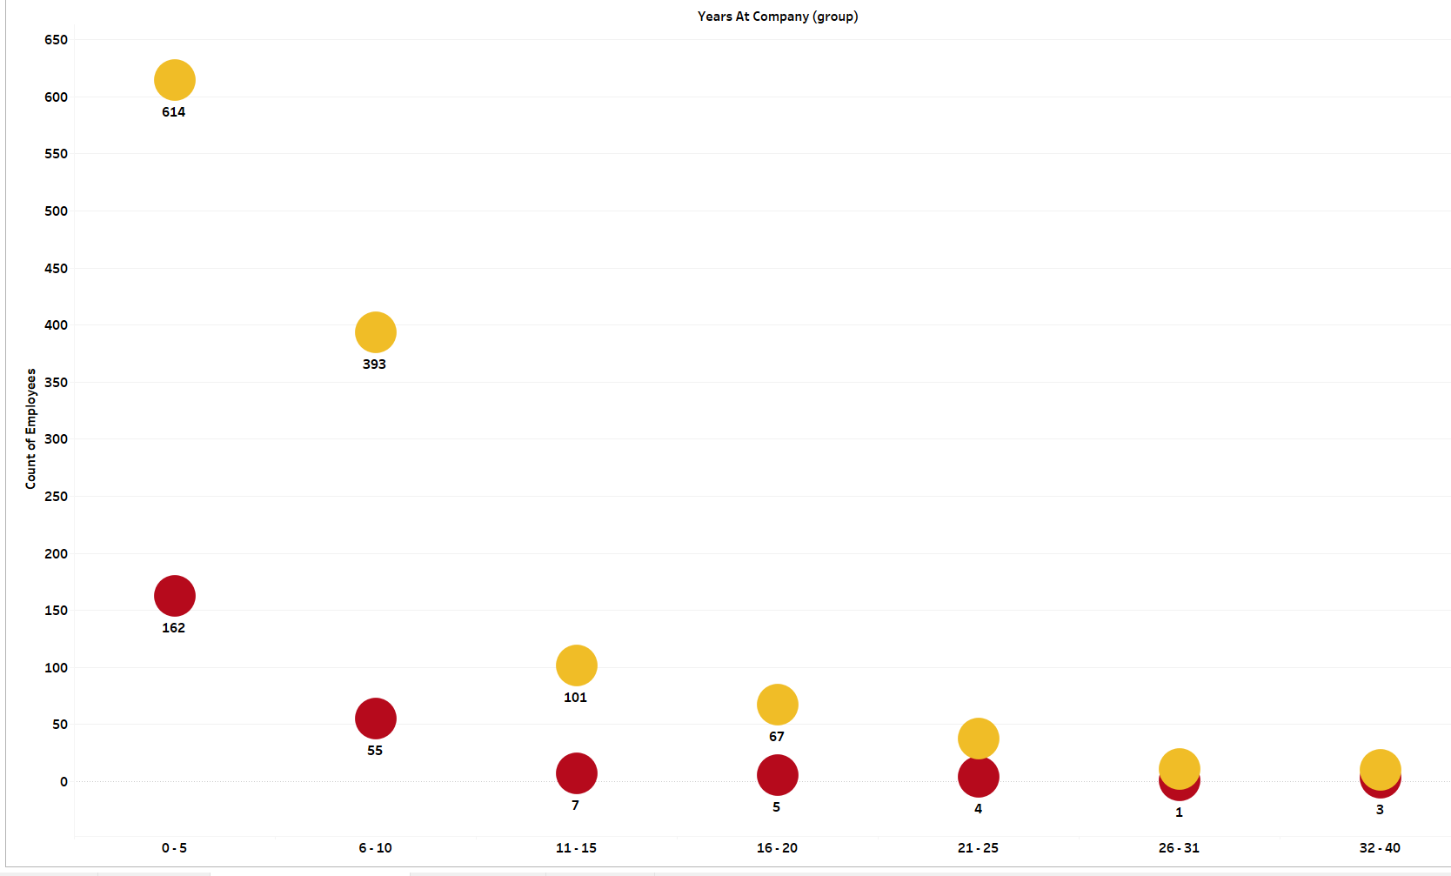
Employee attrition by tenure

Slide 7
Attrition by income

Slide 8
Conclusion
The attrition rate of employee is 16.12 %
As per the analysis employees who’s age is between 26 – 35 has more attrition
The attrition by income shows that the employees who income is less than 4k has high attrition and also only few employees getting highest salary in the company
Only those employees left the company who’s experience is between 0 - 5

Slide 9
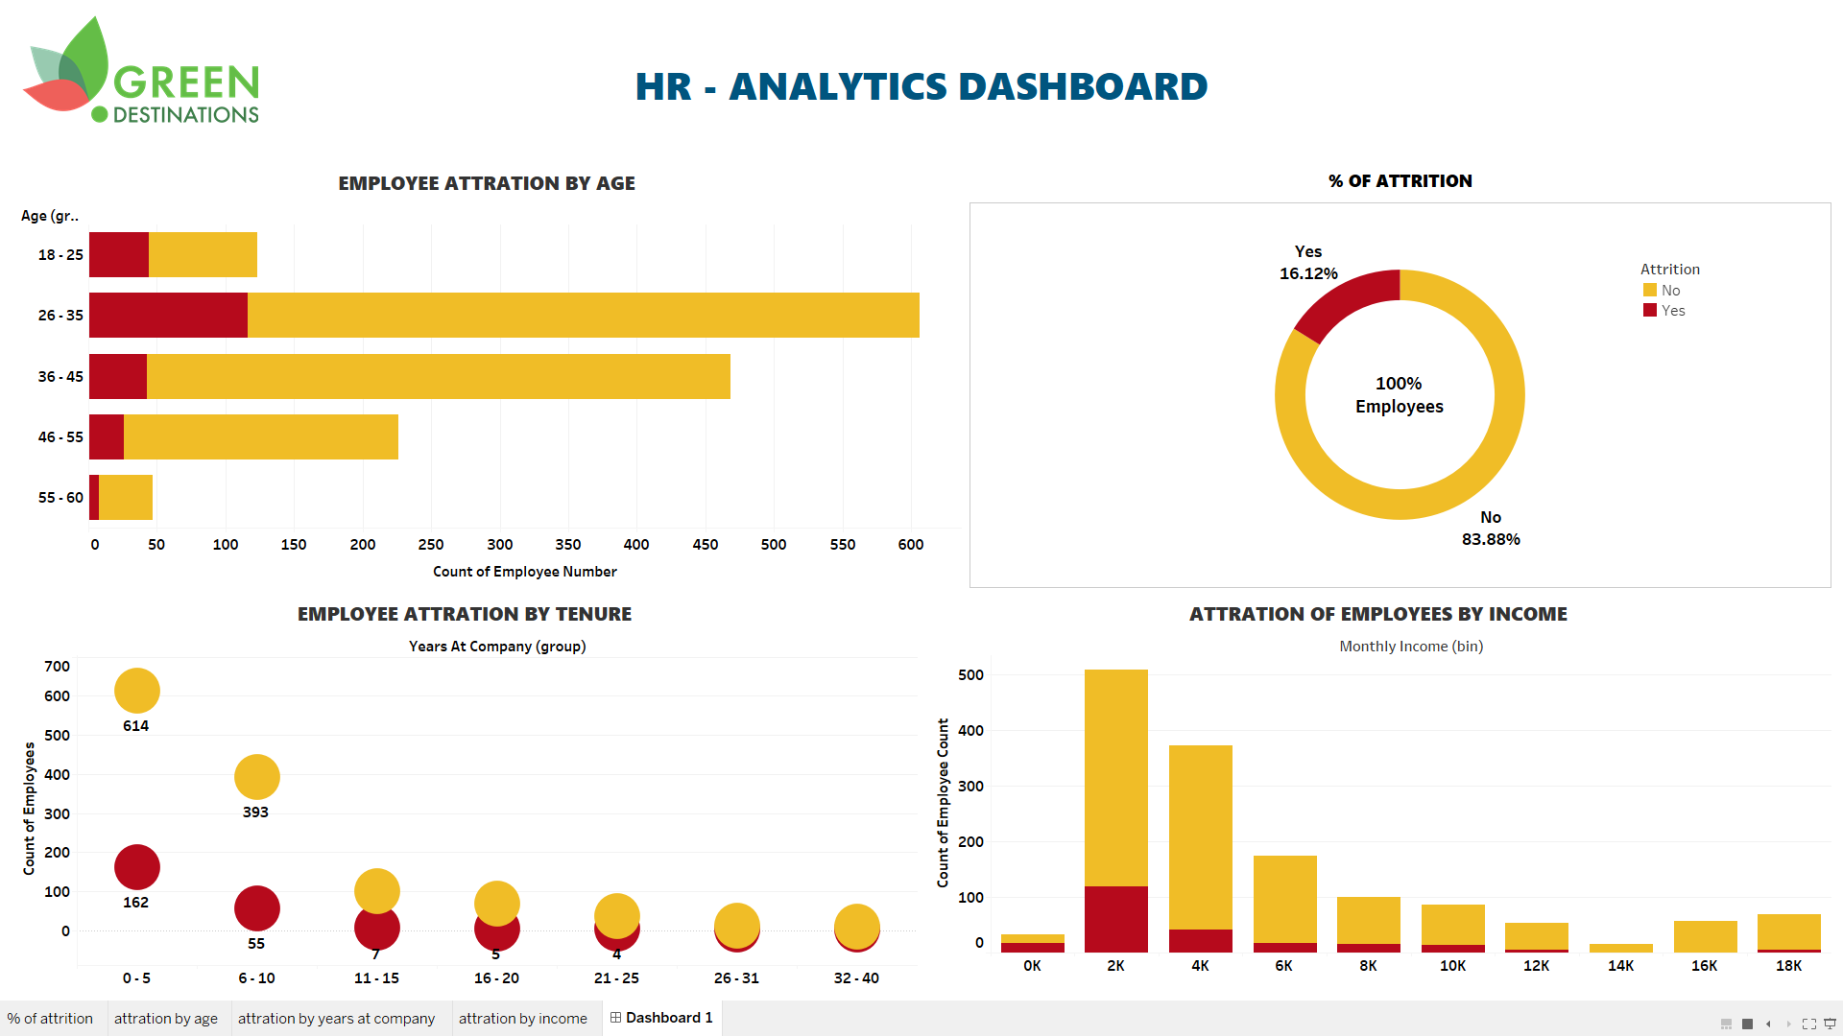
THANK YOU

